Slide 1
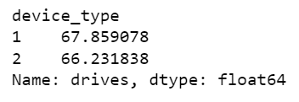
User Churn Project: Two-Sample Hypothesis Test Result
Executive Summary prepared for Waze leadership team
Waze leadership ask data team to develop a churn predictive model that will help prevent churn. improve user retention, and grow Waze’s business. This report is made by Waze data team after performing a statistical analysis to learn more about users’ behavior.
Develop a two-sample hypothesis test to analyze and determine whether there is a statistically significant difference between the average number of rides and device type
This statistical test can help Waze data team to learn more about users’ behavior
The t-test results from two-sample hypothesis test conclude there is not a significant difference in average number of rides between iPhone and android users
Based on descriptive analysis calculation, iPhone users (67.9 drives) and android users (66.2 drives) use the application roughly the same average number of rides
From the two-sample hypothesis test, Waze data team recommends running another t-test on other variables to learn more about users’ behavior
Since the user experience is roughly the same, any changes in marketing or user interface might impact sample data to investigate user churn behavior

